Slide 1
Using AWS S3 with Opensource API
Mobile App Programming

Slide 2
What we learn today?
Let’s connect AWS Lambda with S3(Storage service) to Android Application.
Implement a web server with S3 using boto3.
Simply manage file upload/download task to AWS S3 database.
Make application contains current weather notice function.

Slide 3
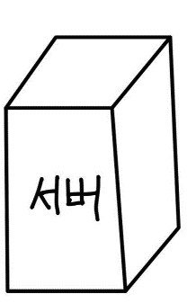
Remind
We connect our lambda flask with postgresQL RDS instance.
We create RDS instance (PostgresQL).
We connect our flask server to RDS instance!
DB
Amazon RDS (PostgresQL DB)

Slide 4
Today.. 1)
We connect our lambda flask with S3 storage service.
We upload or access file to S3 bucket with AWS Lambda flask
(This S3 bucket is already made in past week).
S3
Amazon S3 (File Storage)

Slide 5
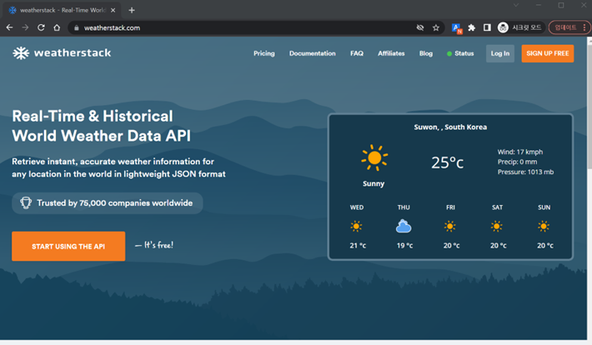
Today.. 2)
We connect our lambda flask with android application.
We use opensource weather REST API in android application
GET Request?=City name
AP
I
Return Current weather

Slide 6
What we learn today?
Process
Check your S3 bucket in amazon web page
Install boto3 and download weather_db.txt file in icampus
Create upload, read function in python flask server
Sign up “https://weatherstack.com/”
Get API Access Key and Make API Request
Exercise - Make an Android weather application with AWS DB

Slide 7
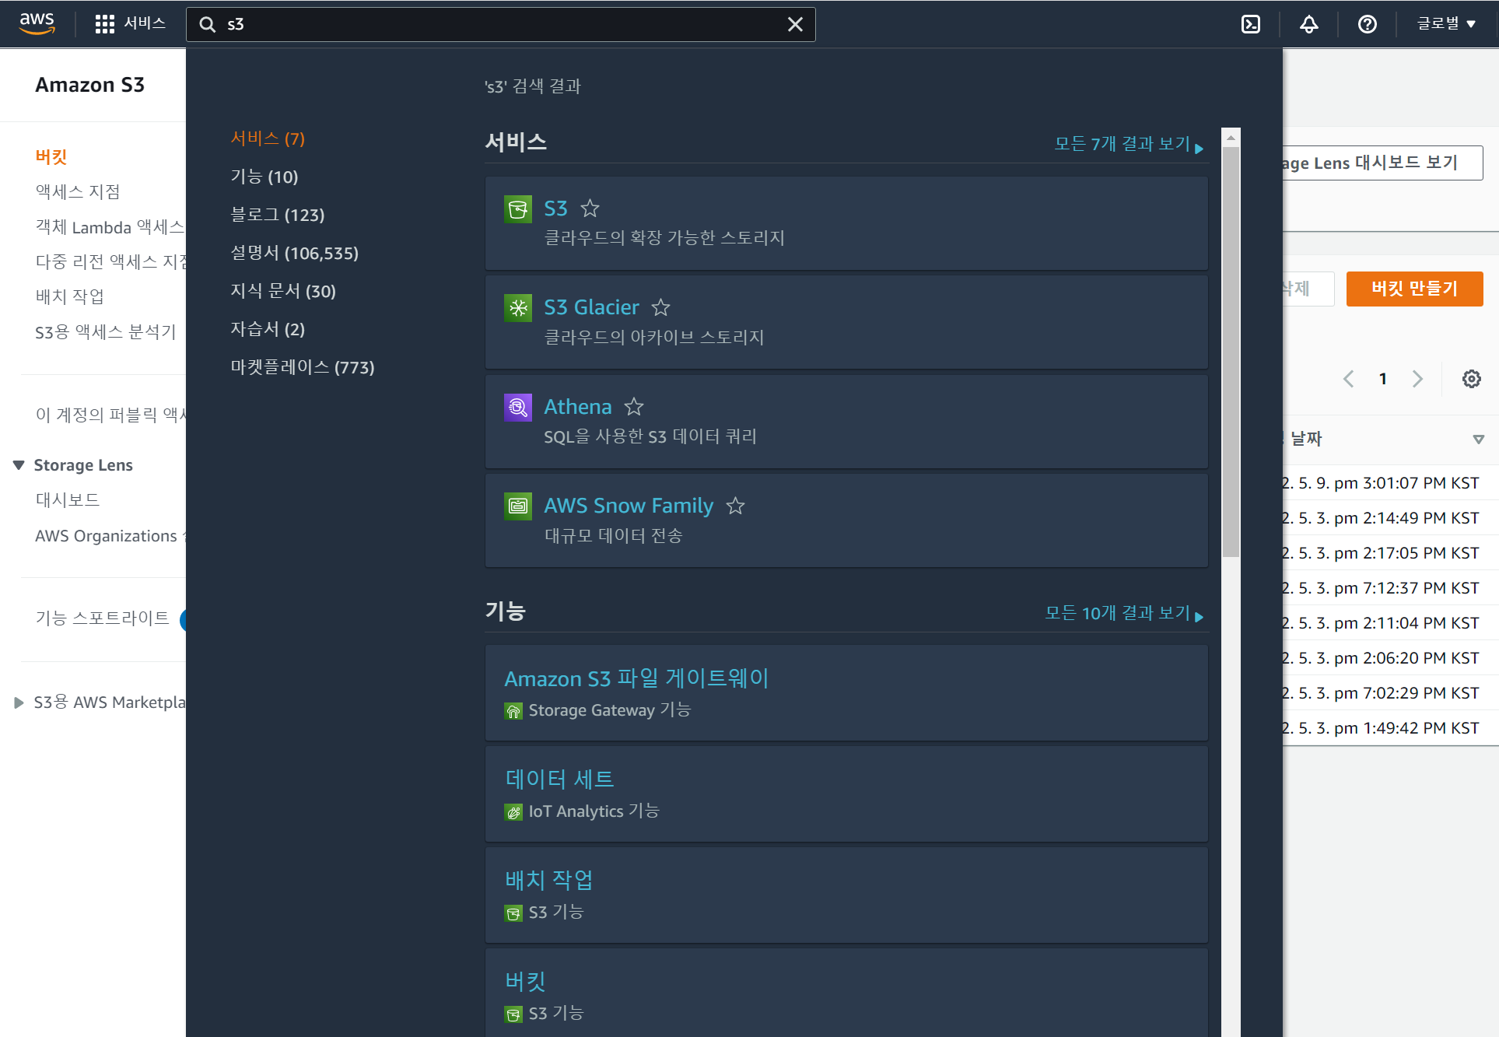
1) Check your S3 bucket set in past week
Go to AWS console, search S3 and select it

Slide 8
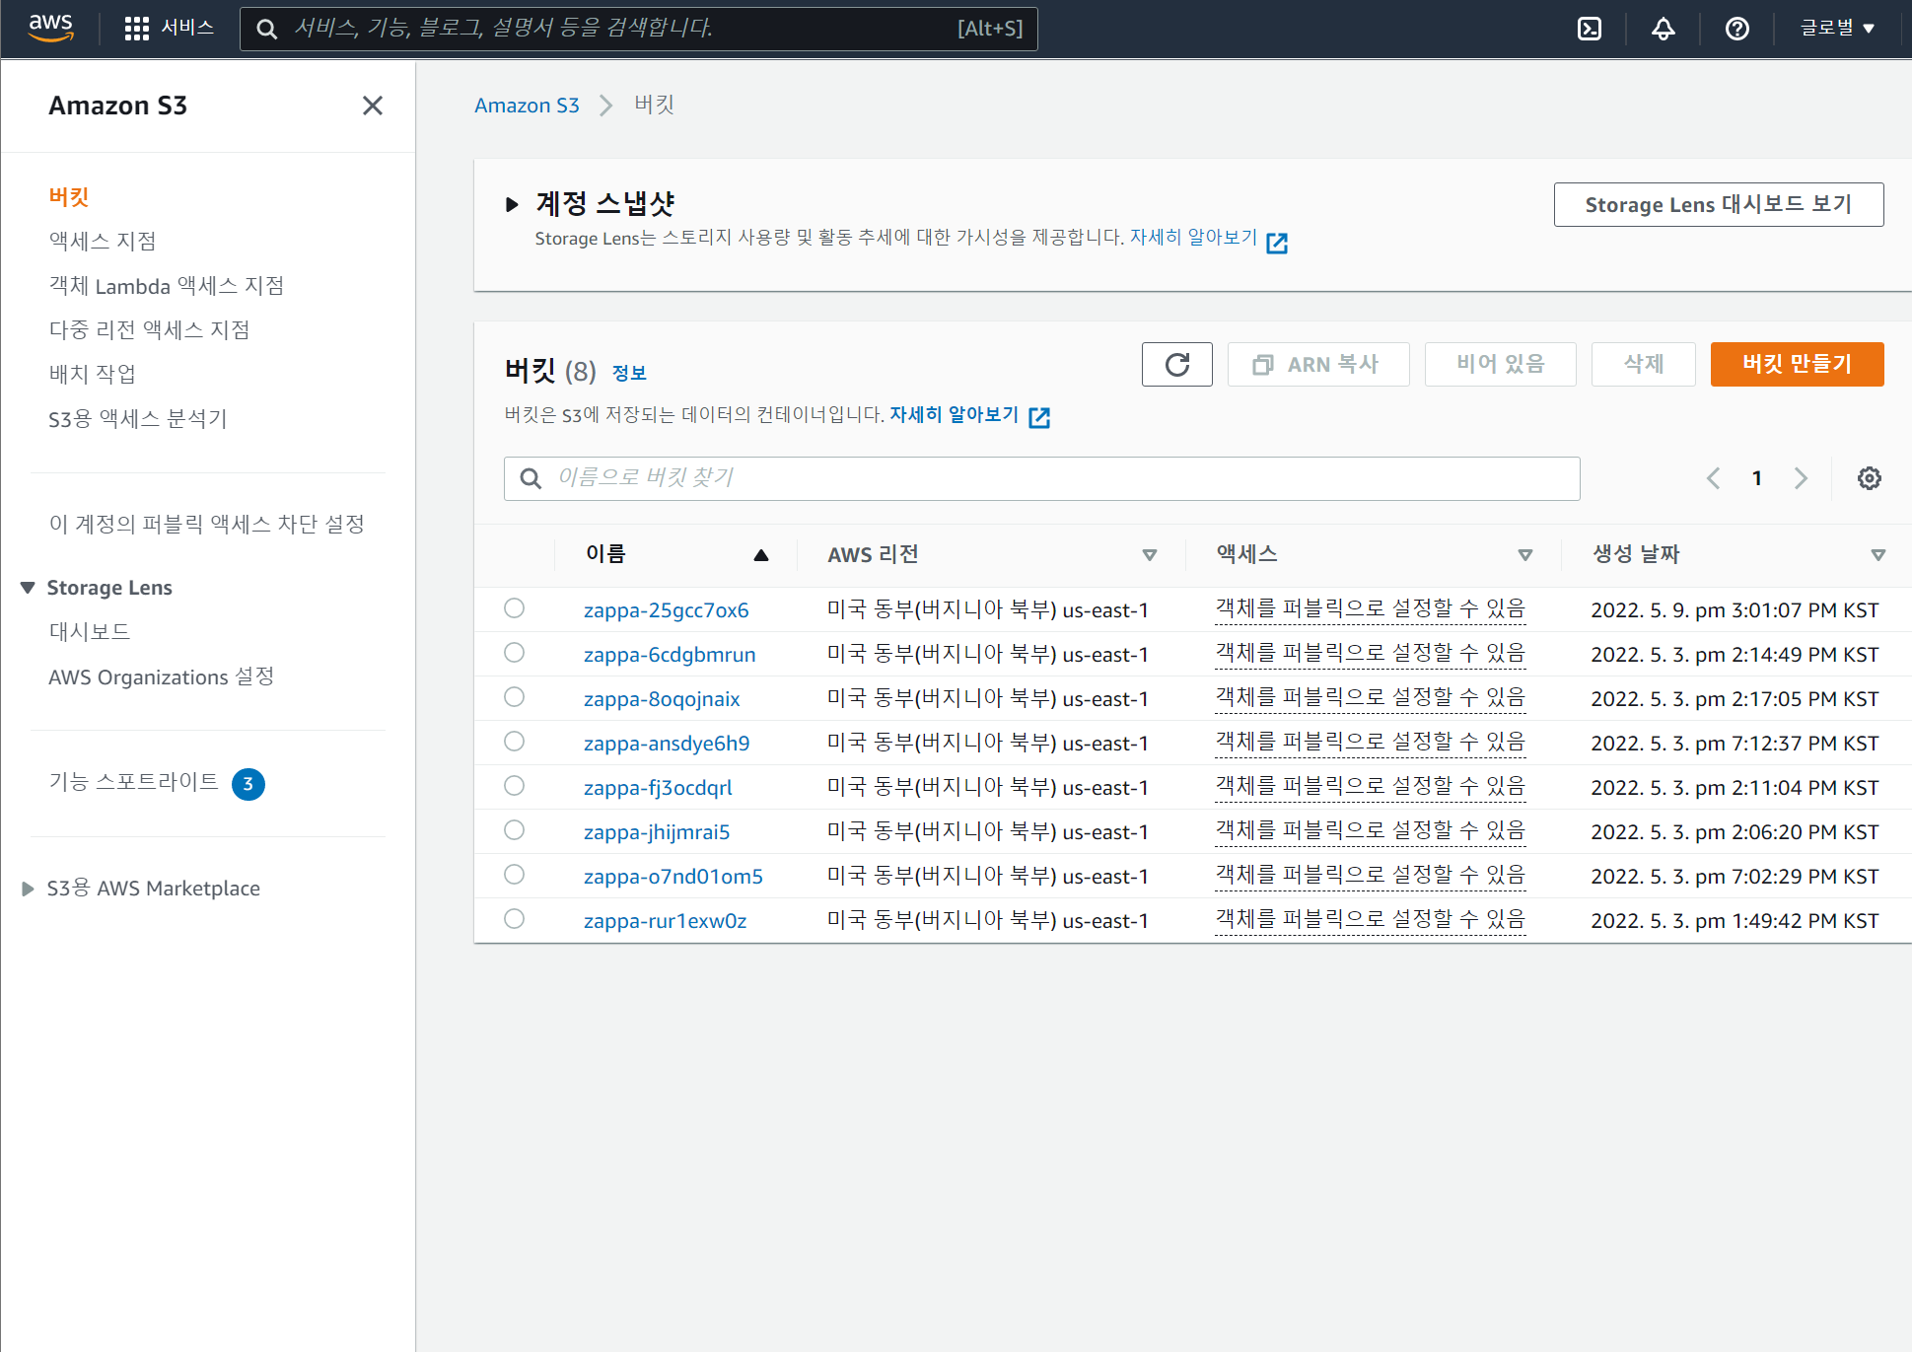
1) Check your S3 bucket name set in past week
Check your “Creation date” tab, remind bucket name created in the past week. Today, we will use this bucket.

Slide 9
2) Install Boto3
Activate Virtual environment and install belows.
In Windows
$ .\[가상환경이름]\Scripts\activate.bat
$ pip install boto3
In Mac
$ source [가상환경이름]/bin/activate
$ pip install boto3
In Linux ( include WSL)
$ source [가상환경이름]/bin/activate
$ pip install boto3

Slide 10
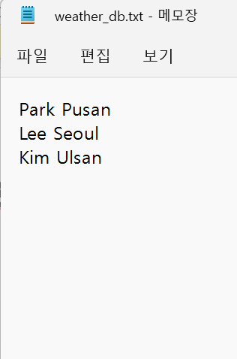
2) Weather_db.txt in icampus
3 line file
Name/1 white space/Region

Slide 11
3) Create upload, read function in python flask server
boto3_test.py
import boto3, io, json
from flask import Flask
from flask import request
from flask import jsonify
from werkzeug.serving import WSGIRequestHandler
WSGIRequestHandler.protocol_version = "HTTP/1.1"
app = Flask(__name__)
file_name="weather_db.txt" # Download from Icampus
bucket_name="zappa-25gcc7ox6" # Your bucket name
file_key="weather_db.txt" # Same with file name
@app.route("/upload", methods=['GET'])
def upload():
global file_name, bucket_name, file_key
s3 = boto3.client("s3")
# case 1 : upload your local file
s3.upload_file(
Filename=file_name,
Bucket=bucket_name,
Key=file_key,
)
# case 2 : upload new file by stringIO body
contents="My string to save to s3 object"
fake_handle=io.StringIO(contents)
s3.put_object(Bucket=bucket_name, Key="stringIO_test.txt", Body=fake_handle.read())
print("upload finish")
return jsonify("upload finish")
1) Initial Client for s3 bucket
2) Make session to upload with S3 bucket!
3) Using local file name, we can easily upload local file to S3
4) Using StringIO library, we can upload new file to S3

Slide 12
3) Create upload, read function in python flask server
boto3_test.py
... Write below of before codes …
@app.route("/access", methods=['GET'])
def access_dat():
global file_name, bucket_name, file_key
name=request.args.get('name’) # Input name for searching region
s3 = boto3.client("s3")
obj=s3.get_object(
Bucket=bucket_name,
Key=file_key,
)
file_data=io.BytesIO(obj["Body"].read())
region="Search failed"
for byte_line in file_data:
line=byte_line.decode().rstrip()
line_arr=line.split(' ')
if line_arr[0]==name:
region=line_arr[1]
return jsonify(region), 200
if __name__ == "__main__":
app.run(host='localhost', port=8888)
Send GET Method to flask server,
with ”name” condition
Get_object function can take “weather_db.txt contents
You should decode bytestream data, before searching
You can search name, region pair in file data

Slide 13
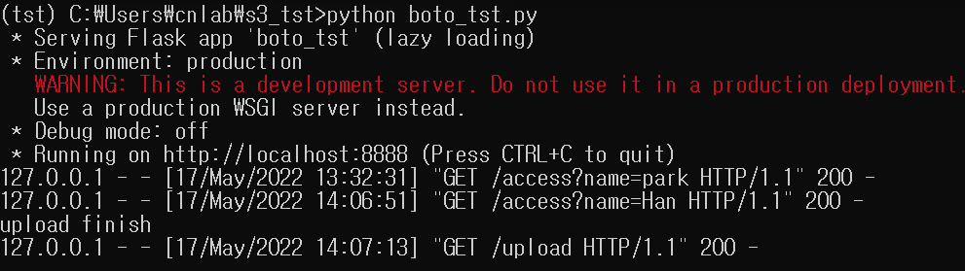
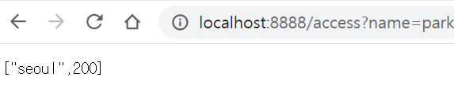
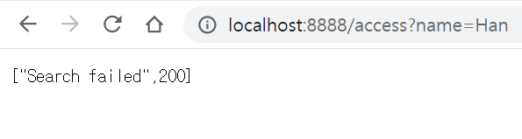
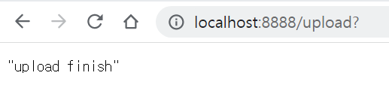
3) Create upload, read function in python flask server
boto3_test.py

Slide 14
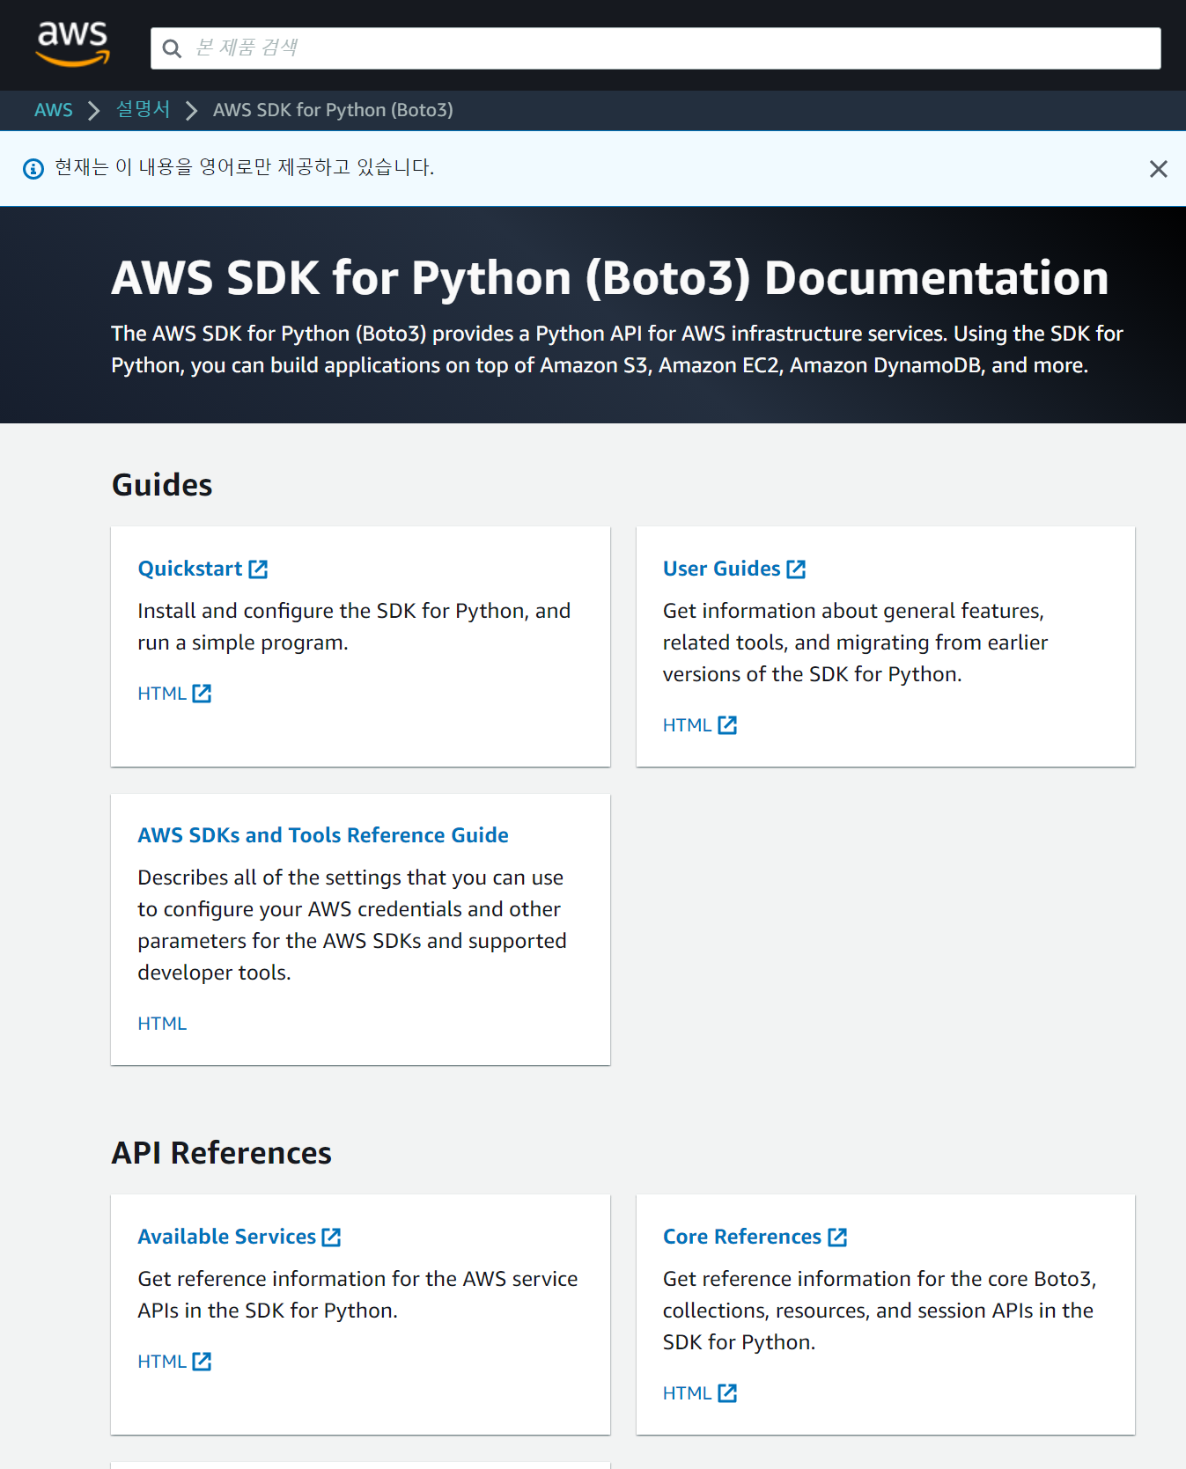
3) Get API Access Key and Make API Request
If you want to know about search bucket connect, file transfer configuration, etc..
Please check below links “AWS SDK for Python (Boto3) Documentation”!
https://docs.aws.amazon.com/pythonsdk/?id=docs_gateway

Slide 15
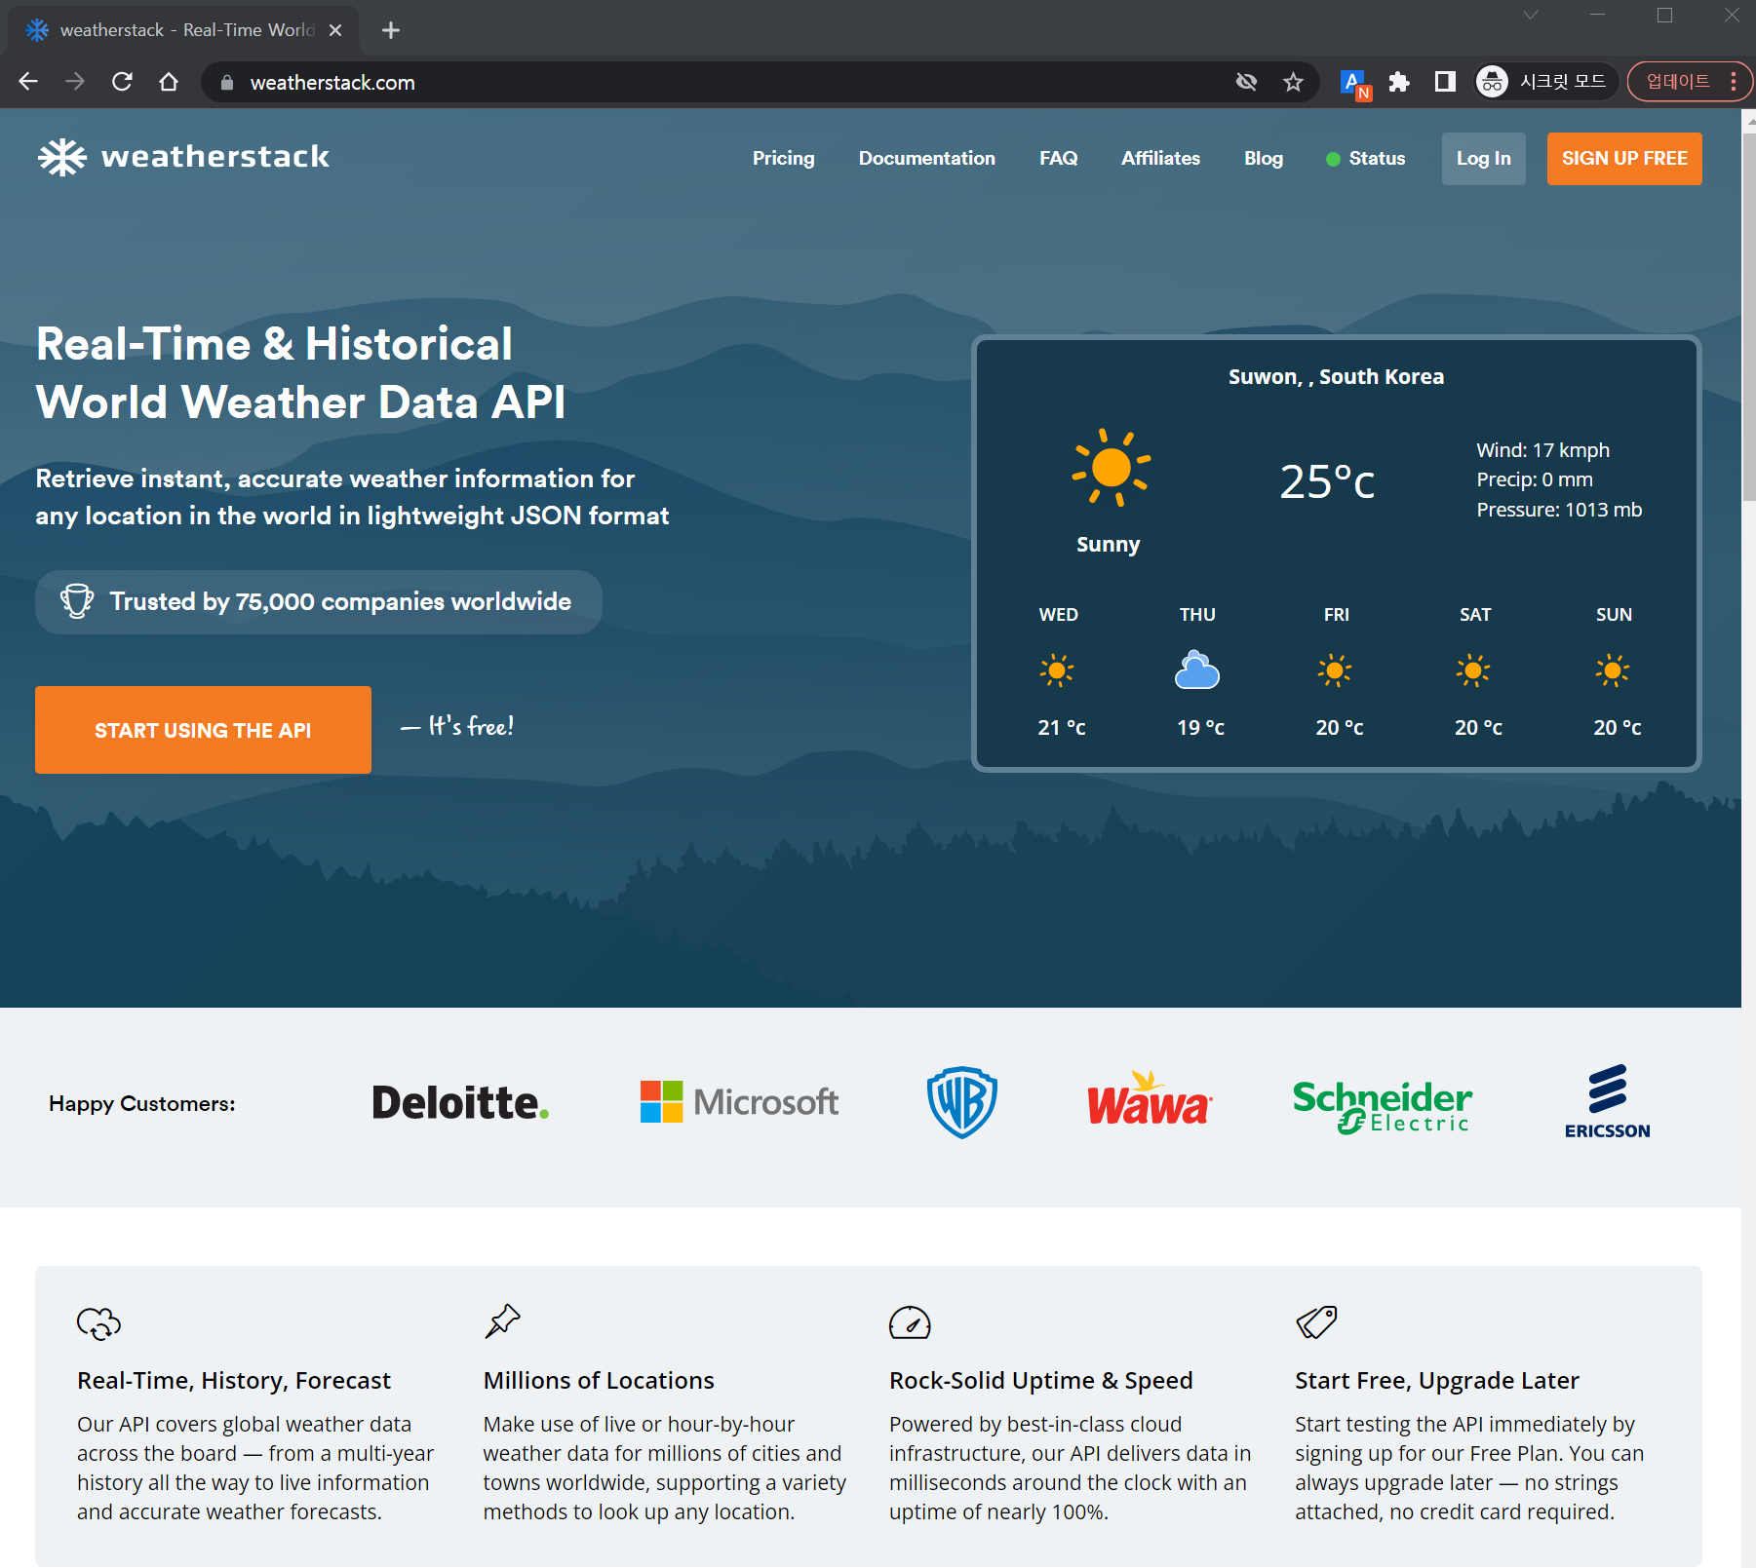
4) Sign up “https://weatherstack.com/”
Sign up https://weatherstack.com/
https://weatherstack.com/ provide opensource weather API.
Click!!

Slide 16
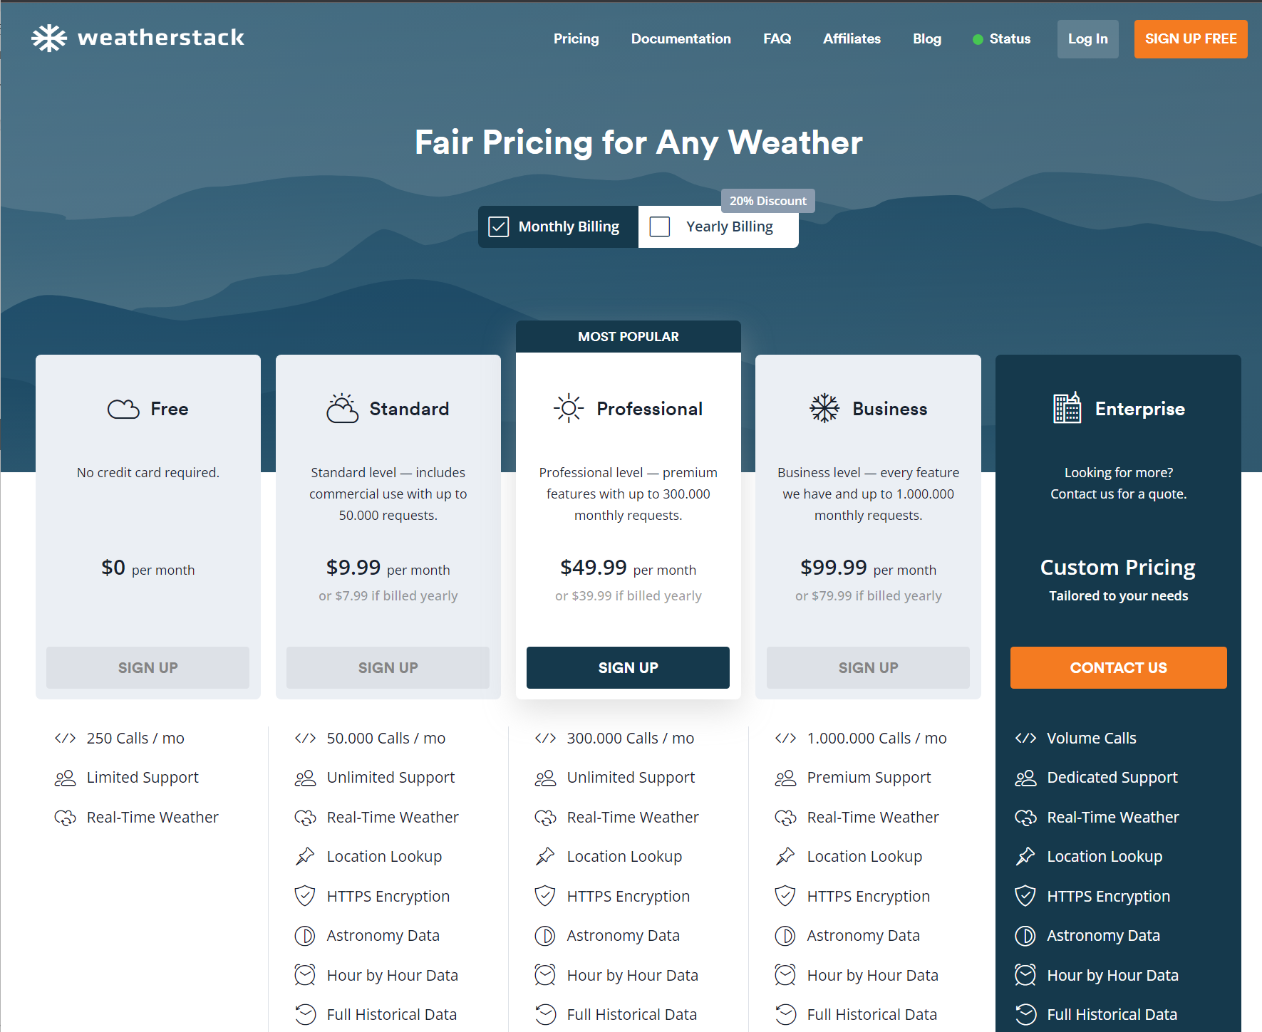
4) Sign up “https://weatherstack.com/”
Sign up https://weatherstack.com/
https://weatherstack.com/ provide opensource weather API.
Click!!

Slide 17
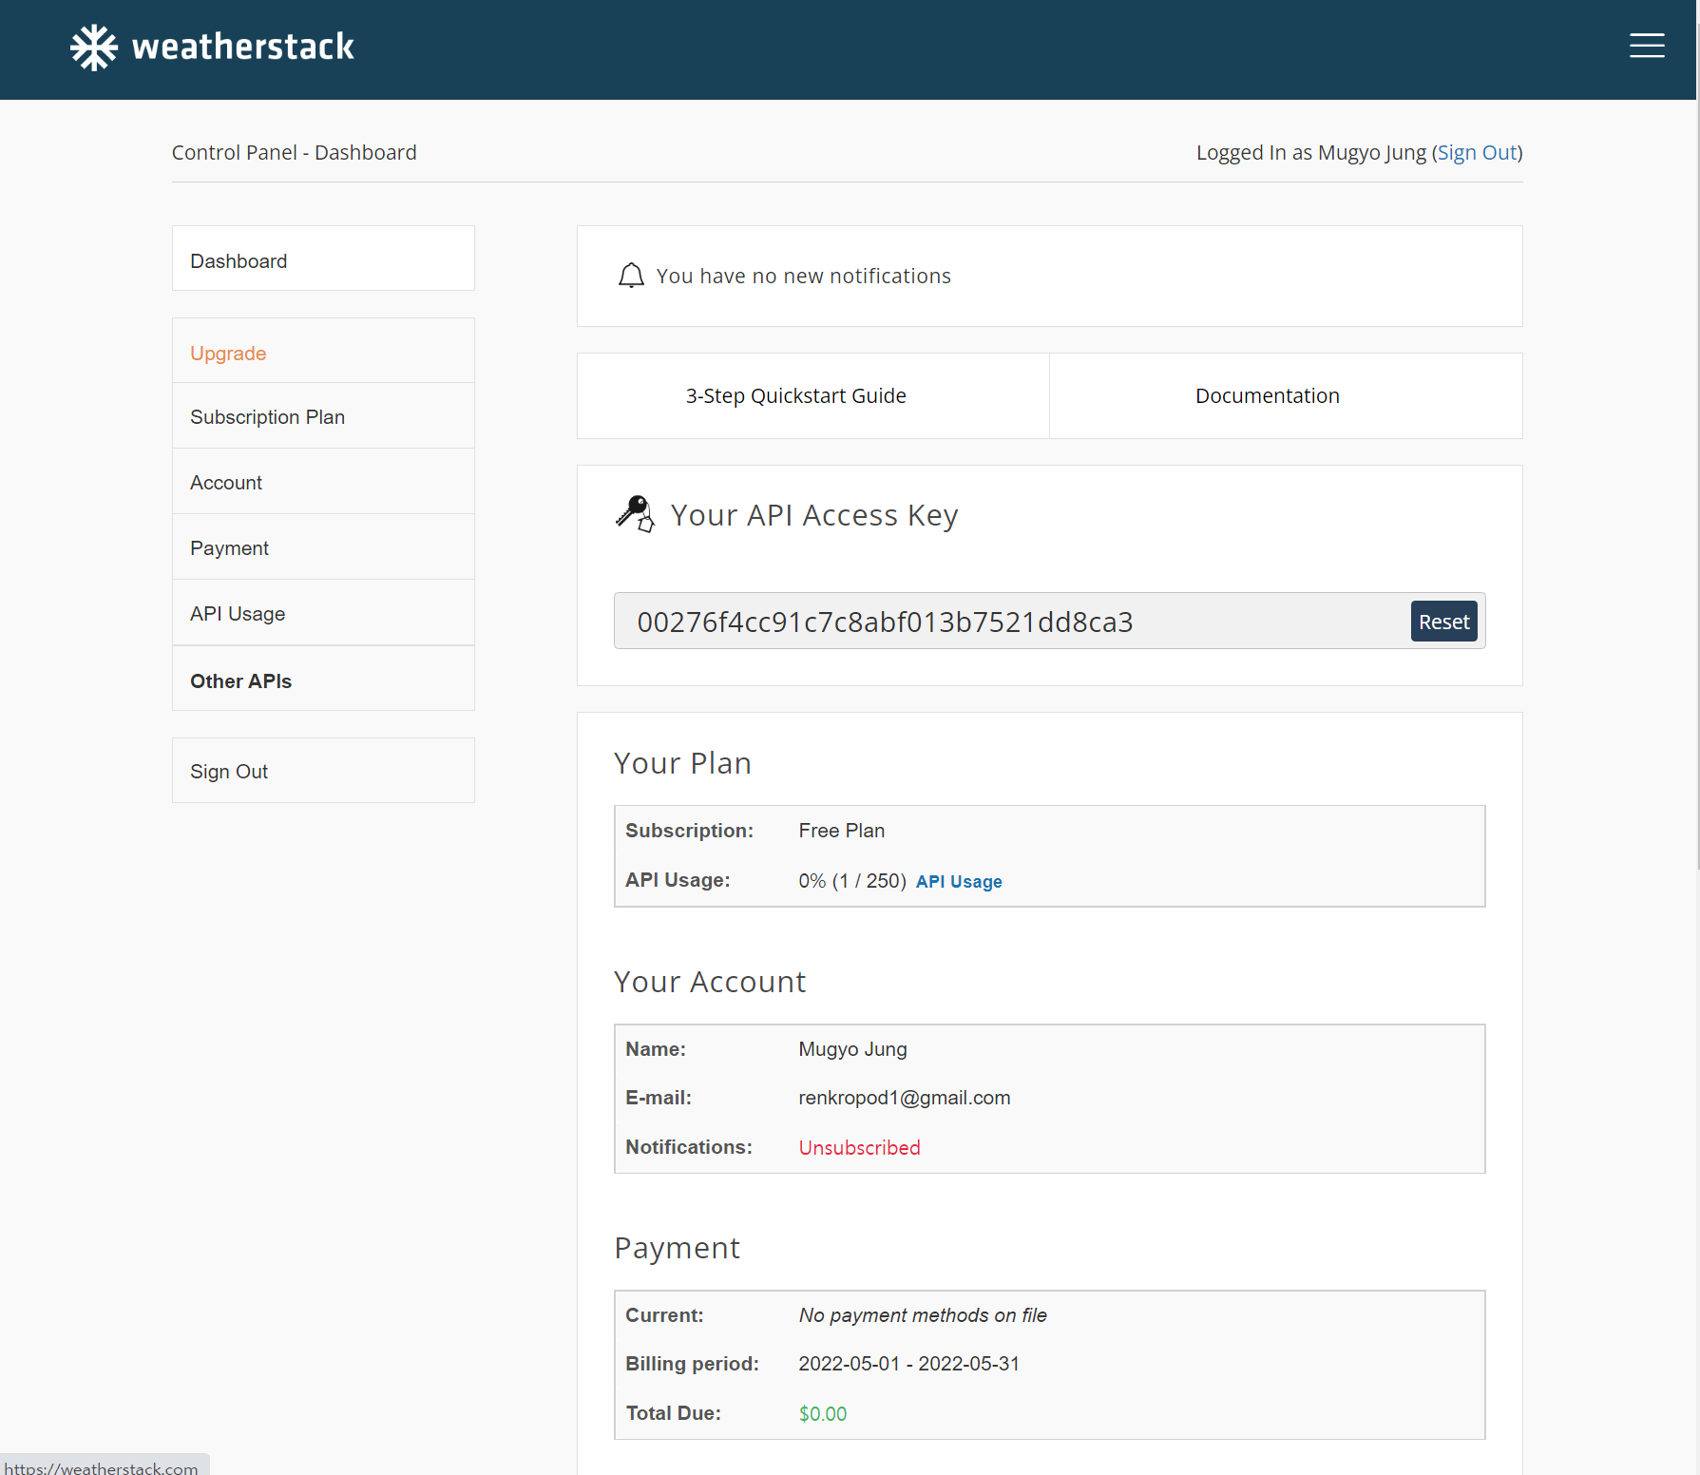
5) Get API Access Key and Make API Request
After Sign up, you can get your API Access Key in Dashboard
Click the 3-Step quick start Guide
Click!!

Slide 18
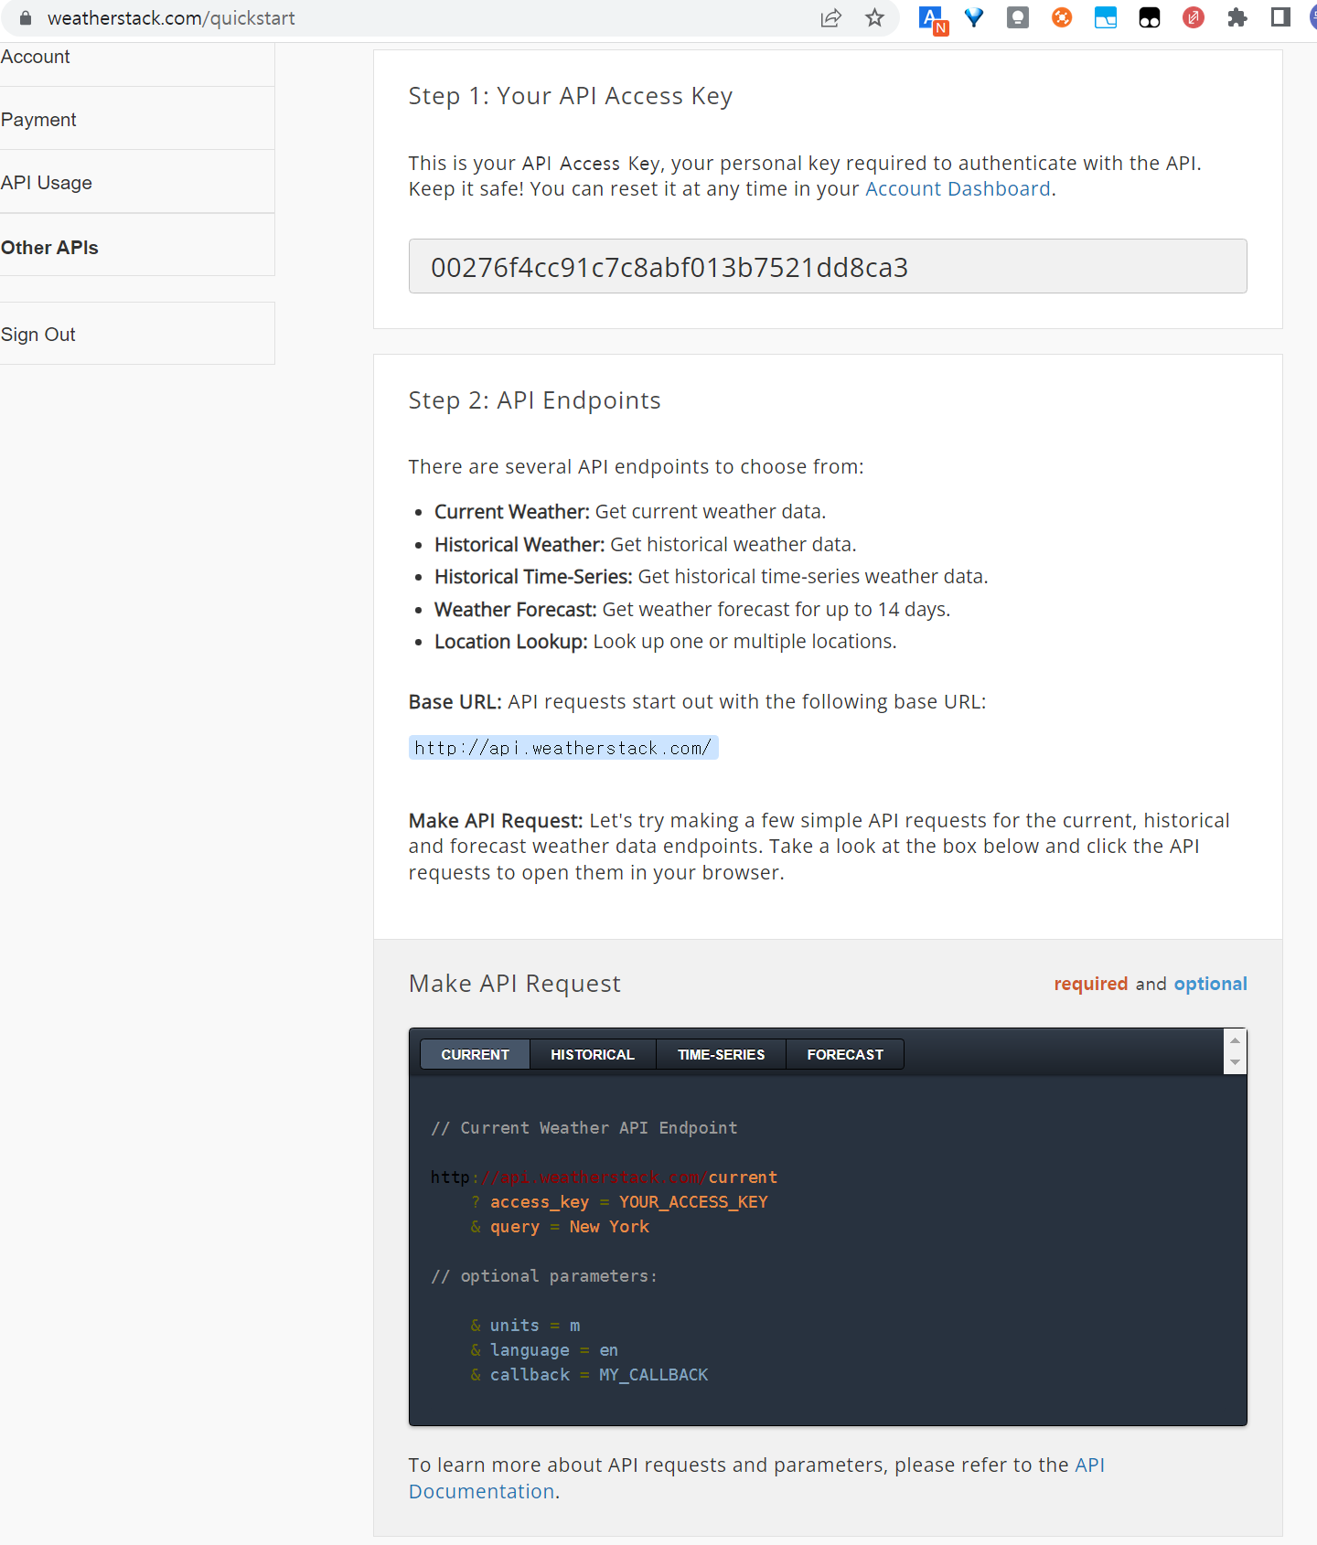
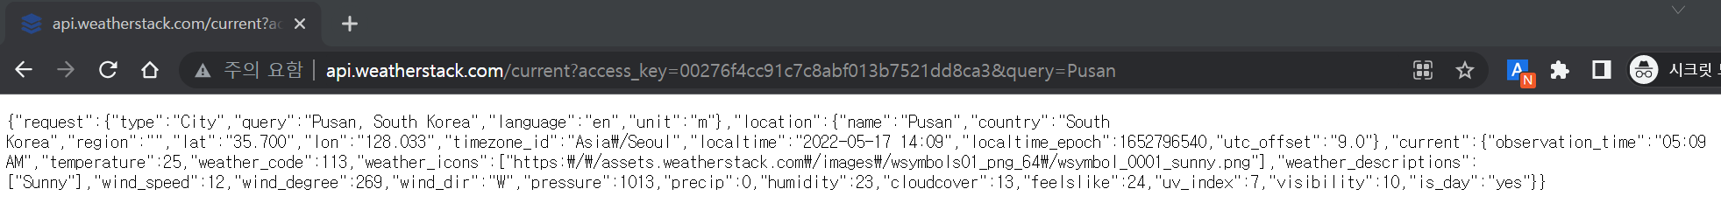
5) Get API Access Key and Make API Request
Now, you can get current weather information by city name
http://api.weatherstack.com/current?access_key=[Your Access Key]&query=[City Name]

Slide 19
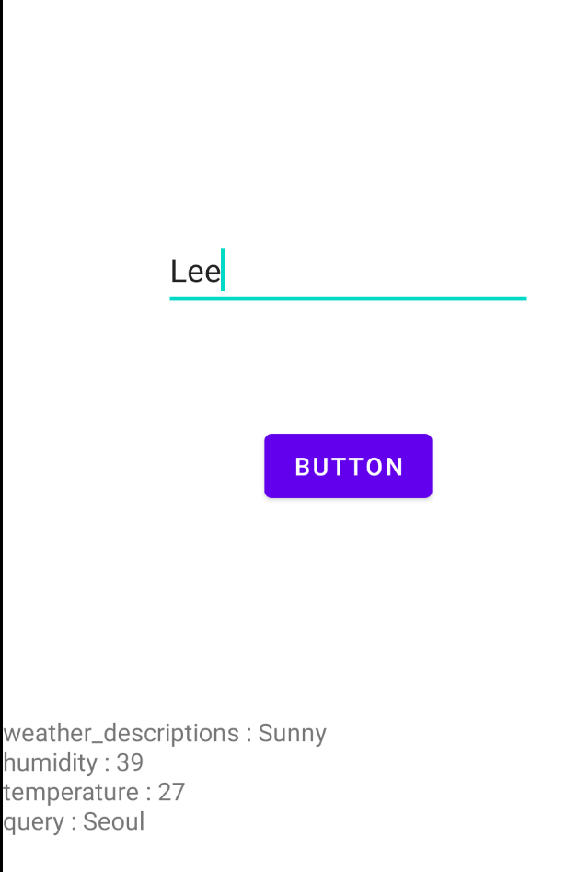
Exercise – Weather check service with AWS Lambda in Android Application
5.GET Request?=City name
4.Region(ex.Seoul) <- Return JSON
3.Return file contents
AP
I
S3
6.Return Current weather
2.Request “weather_db.txt”
1. GET Request?=name(ex.Lee)
Make an android application communicate with AWS S3 and Opensource API
0) user input “name” to edittext (android application)
1) send GET request to AWS Lambda flask server (android application)
2) access “weather_db.txt” to AWS S3 storage (Lambda flask server –boto3)
3) read the file contents, and find the matching region with the input name
(Lambda flask server)
4) return JSON to android application (Lambda flask server)
5) send GET request to weather API (android application)
7. Json string will be printed Current weather

Slide 20
Exercise – Weather check service with AWS Lambda in Android Application
5.GET Request?=City name
4.Region(ex.Seoul) <- Return JSON
3.Return file contents
AP
I
S3
6.Return Current weather
2.Request “weather_db.txt”
1. GET Request?=name(ex.Lee)
Make an android application communicate with AWS S3 and Opensource API
6) return current weather information (Weather API)
7) Json string will be printed (android application) <ignore example picture>
Application should parse 4 parameters
Weather_descriptions, Temperature, Humidity, name(City Name)
7. Json string will be printed Current weather

Slide 21
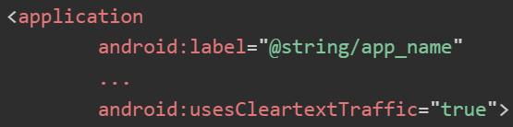
Exercise – Weather check service with AWS Lambda in Android Application
5.GET Request?=City name
4.Region(ex.Seoul) <- Return JSON
3.Return file contents
AP
I
S3
6.Return Current weather
2.Request “weather_db.txt”
1. GET Request?=name(ex.Lee)
Android Application
Using week 8 omdb api lab session project code
cf.) you should add usesCleartextTraffic=“true” to AndroidManifest, to allow access to all HTTP URLs
Opensource Weather API
Using this week contents, https://weatherstack.com/ API
AWS Lambda Flask with S3
Using this week example upload/download code
Submit single zip file with name “<Student ID>_w13.zip”
Export to zip -> Change file name
Do not care about ending ‘-<Number>’ (ex: 2022524288-1.zip)
7. Json string will be printed Current weather

